Slide 1

KNOWLEDGE INSTITUTE OF TECHNOLOGY
ASIC DESIGN FLOW
PREPARED BY
V.LEKHA M.E
ASSISTANT PROFESSOR/ECE

Slide 2
ASICS
What are ASICS?
Any IC other than a general purpose IC which contain the functionality of thousands of gates is usually called an ASIC(Application Specific Integrated Circuit). ASICs are designed to fit a certain application.
An ASIC is a digital or mixed-signal circuit designed to meet specifications set by a specific project.
•

Slide 3
ASIC Project
ASIC design team (Project leader, designers for different tasks)
Information share with closely related projects/design teams (software, analog HW design, system design) - Documentation!
ASIC project is a part of bigger project - Scheduling is important!
Design flow must be defined and approved

Slide 4
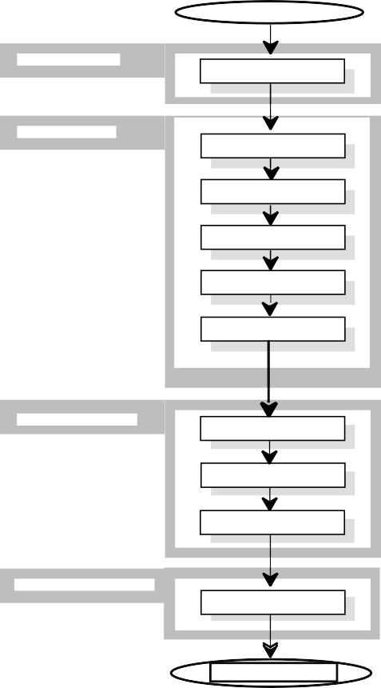
ASIC Design Flow
SYSTEM REQUIREMENTS
SPECIFICATION
SPECIFICATION
LOGIC DESIGN
MODELLING
LOGIC DESIGN
SYNTHESIS
VERIFICATION
TEST GENERATION
PHYSICAL
SIGN-OFF / Mapping
MANUFAC / Place & Route
/ Configuration data
PROTOTYPE
PROTO VERIFICATION
SYSTEM TESTING
SYSTEM TESTING

Slide 5


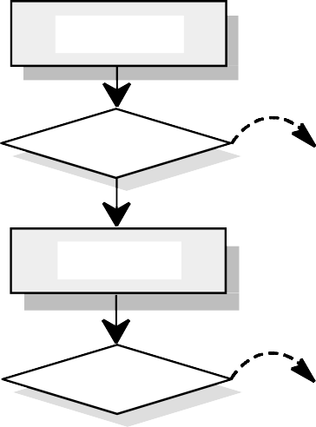


ASIC Specification
The goal is to specify the functional requirements for the design and define the external interfaces to the related designs.
SYSTEM REQUIREMENTS
SPECIFICATION
System Req. Specification System Func. Specification ASIC Project Plan
Tools
Re qui r e me n Spe c i f i cat
e. g. Wo r d
REQ. SPEC REVI EW
Re qui r eme nt Spec i f i c at i
Da t a
Spe c i f i cat
e. g. Wor d
DATA SHEET
Dat a Sheet
MODELLING

Slide 6
ASIC Modeling
The goal is to build a simulatable (behavioral) VHDL model corresponding to the specification.
The function of the model is verified by using a VHDL test bench
Architecture design
Model validation ok
-> Logic design

Slide 7
Logic design
The goal is to write a synthezisable VHDL description of the design
Design rules (Naming, vendor independence, Use only IEEE standard types, comments, …).
Reusing
Synchronous design !!
Design partitioning (into RTL blocks)

Slide 8
Naming rules
Use meaningful names for signals, ports, functions and parameters. For example, do not use ra for a RAM address bus. Instead, use ram_addr or RamAddr (capital letters can also be used).
If your design uses several parameters, use short but descriptive names.
Use the name clk for the clock signal. If there is more than one clock in the design, use clk as the prefix for all clock signals (for example clk4m, clk8m).
Use the same name throughout the hierarchy for all clock signals that are driven from the same source.
For active low signals, end the signal name with an underscore followed by a lowercase character x.
Use the name reset for reset signals. For active low resets use the name reset_x.
For multibit buses, use (y downto x) ordering of bits.

Slide 9
Guidelines for clocks and resets
The preferred clocking structure is a single global clock and positive edge-triggered flip-flops as the only sequential devices.
FF
FF
clk

Slide 10
Guidelines for clocks and resets
Digital ASICs must be designed to be synchronous when possible. This must be considered, when VHDL for synthesis is written. The main benefits of synchronous design are:
  Timing problems are avoided. Only the propagation of signals to the next register during one clock cycle must be verified.
  Most of the problems with hazards are avoided.
  The X-states and glitches in gated and multiplexed clocks are avoided.
  It is easier to test a synchronous circuit than an asynchronous one.
  Static timing analysis is possible.

Slide 11




Guidelines for clocks and resets
partition the design so that all the logic in a single module uses a single clock and a single reset.
Isolating clock and reset generation logic in a separate module allows the other modules to use the standard timing analysis and scan insertion techniques. It also makes it easier to develop specific test strategies for the clock/reset generation logic.
m
aster clock | Clock Generation | clk1 | submodule 1
 |  | clk2 | submodule 2
 |  | clk3 | submodule 3

Slide 12
Guidelines for clocks and resets
Avoid gated clocks
Clock gating circuits tend to be technology specific and timing dependent. Improper timing of a gated clock can generate a false clock or glitch, causing a flip-flop to clock in the wrong data. Also, the skew of different local clocks can cause hold time violations.
Gated clocks also cause limited testability because the logic clocked by a gated clock cannot be made part of a scan chain.
FF FF
clk

Slide 13
Guidelines for clocks and resets
If your design requires gated clocks, use preferably vendor provided gated flip-flop elements using master clock.
data
enable
master clock
reset

Slide 14
Guidelines for clocks and resets
Avoid internally generated resets
Make sure your registers are controlled only by a single reset signal.
Avoid internally generated, conditional resets if possible. Generally, all the registers in the macro should be reset at the same time. This approach makes analysis and design much simpler and easier.
If conditional reset is required, create a separate signal for the reset signal, and isolate this in a separate module. This approach results in more readable code and improves synthesis results.

Slide 15
Design partitioning
Good partitioning in the design provides several advantages including:
Easy handling of design requires sensible hierarchy Better synthesis results
Faster synthesis compile runtimes
Ability to use simpler synthesis strategies to meet timing Reusability

Slide 16
Design partitioning
Locate related combinational logic in a single module and single process if possible
The synthesis tool has more flexibility in optimising a design when related combinational logic is located in the same module. This is because synthesis tools cannot move logic across hierarchical boundaries during compile operation.
A
B
C
clk
FF A
COMB A
COMB B
COMB C
clk
FF C
Bad
A
C
clk
FF A
COMB
A & B & C
FF C
Better
clk
A
C
clk
FF A
COMB
A & B & C
 | FF C
clk
Best

Slide 17

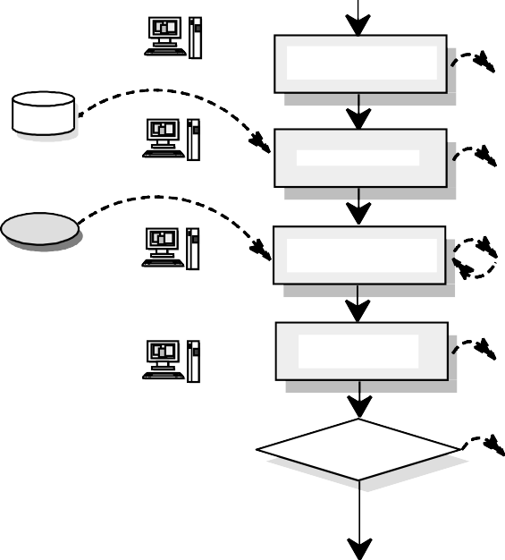
RTL block design
RTL
RTL Bl oc k
VHDL Sch.,DFD
Ar chi t ect ur e
Pl an/ De s c r i pt i
Te x t
Synt he s i z a bl e Bl oc k
VHDL
Target technology
RTL VHDL
Tar ge t
dat a
De s i gn
Synt he s i s
Schematics
Sc he mat i c
VHDL TB
RTL Bl oc k
simulation results
VHDL Te s t Be nc h
Me nt or VS S
St i mul
Re sponse
RTL
Do c u me nt a t i o
VHDL,DFD
Te x t
Adde d c omme nt s
Bl oc k Re vi e w
RTL Block
Re l e as e d RTL
RTL Mod e l I nt e gr a t i

Slide 18



Synthesis
LOGIC DESIGN
SYNTHESIS
VHDL
RTL VHDL Mo de l
e. g. Te x t
Pr e par at i
VHDL Sch.,DFD
RTL VHDL Mo de l opt i mi z e d f or
Generic technology
Ge ne r i c
dat a
Mo dul e Synt he s i
Schematics
De s i gn Compi l e r
Te s t Compi l e r
Sc he mat i c
bas e d on ge ne r i c
Ma ppi ng
Schematics
Sc he mat i c
bas e d on t ar ge t
Target technology
ASI C t e s t synt he si s ,
Schematics
Tar ge t
dat a
Sc he mat i c
adde d t e s t s t r uc t ur e
Opt i mi zat i
Schematics
Sc he mat i c
opt i mi z e d f or t ar ge t
Ti mi ng
Ti mi ng
VERIFICATION

Slide 19




Gate level verification
CHIP VERIFICATION
AS I C/ FPGA RTL
Synthesis
Opt i mi z e d
Sy nops y s De s i gn or FPGA
or e qu^{i} i v al e nt
Static timing analysis
Qui c k check
Ti mi ng
Netlist creator Ne t l i s
Sy nt he s i s Li br ar
AS I C/ FPGA
gat e
Te s t be nc h, St i mul i Functional simulation
be h. mode l Re sponse s
Aut omat i c / ma nua c ons t r ai n
Functional errors
VHDL/ gat e l e ve l
Mapping (FPGA)
Mappi ng
i nf or mat i
Floorplanning
Fl oor pl anni n
i nf or mat i
AS I C/ FPGA v e ndor t ool s
Place&route (FPGA)
FPGA
i mp l eme nt at i
AS I C/ FPGA
Ce l l
Static timing analysis
Ti mi ng
Te s t be nc h, be h. mode l
St i mul i
Re sponse s
Timing simulation
Dat a Sheet
VHDL/ gat e l e ve l i
Timing errors

Slide 20


Test generation
CHIP VERIFICATION
Chip gate level schematic
with test structures
TEST GENERATION
Pr e l i m. t e s t pa t t e r n
Test Patterns
AS CI I
(ASIC only)
Pr e l i mi nar y
Ma nua l t e s t pa t t e r n
Test Pattern
AS CI I
Ma nual : RAM . .
Test Compiler Plus
Aut o ma t i c pa t t e r n
Test Pattern
AS CI I
Aut omat i c
Te s t
Si mu l a t i on
Test pattern responses
AS CI I
Te st dat a: st i mul i +
VeriFault
Fa ul t
Ve r i f i e d Chi p
Layout

Slide 21
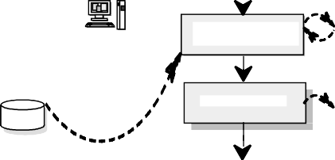

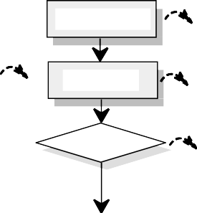
Layout and sign off
TEST GENERATI ON
Layout
Schema Netlist
(ASIC)
Desi gn, t est dat a
Pr e l a yout
simulation results
Vendors Desi gn
St i mul
Response
Target technology
Tar get
dat a
Pl ace & Rout e
Design
GDS I I
Pos t l a yout
simulation results
St i mul
Response
Back annot a t e t o St a t i c Ti mi ng
Back annotation
Ti mi ng f i l e t o
Vendor
De s i gn DRC, LVS
Repor t
Si gn of f
Manuf ac t . agr e e me nt
MANUFACTURI NG PROTO TESTI NG

Slide 22
Prototype testing
Final verification is done with E/S (engineering samples).
Physical measurements:
Parametric DC tests Parametric AC tests Functional tests Power consumption Thermal tests
Release to system tests
Final documentation and project completion
Chips manufacturing

Slide 23
FPGA prototyping
FPGA, Field Programmable Gate Array
VHDL coding for FPGAs (design partitioning, limited maximum clock speed, limited amount of interfaces)
Building prototyping board
Prototyping in laboratory environment

Slide 24
FPGA prototyping
Advantages:
VHDL is tested with real clock speed, in real environment Prototyping environment offers "early ASIC" for other projects More secure to sign off
Disadvantages
Requires a lot of time and resources Expensive

